Slide 1
Eco With You
An experiment into Agile software development.
Bradley, Charlotte, Maddie, Rachel, Tom B & Tom T

Slide 2
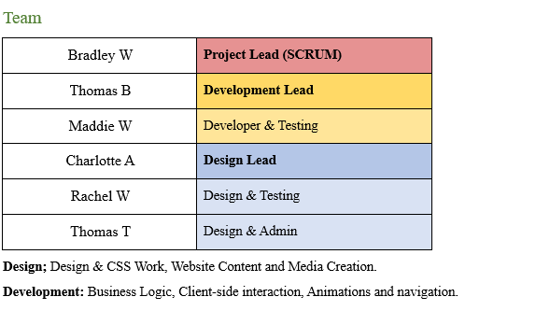
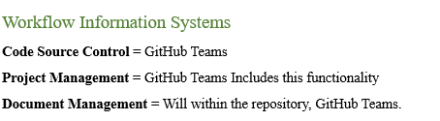
Initial Planning and Development
One of the first steps of the project was outlining a general timetable for the Agile sprints.
Next we outlined our general roles, dividing responsibilities amongst team members.
We also spent this time deciding on a project framework, choosing GitHub as it kept everything within the same ecosystem.

Slide 3

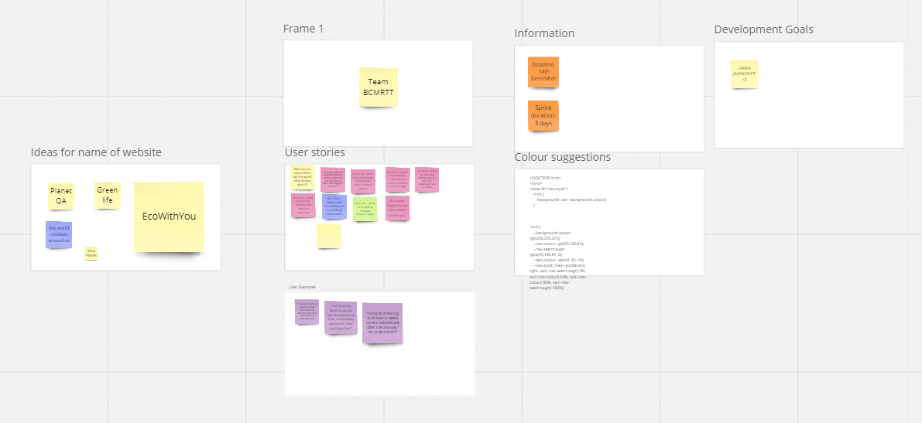


Research, Ideas & Communication
We used an online whiteboarding software called Miro to collate our ideas quickly.
Miro allowed all of us to contribute suggestions at the same time with little difficulty.
We would use discord and signal for communicating and organising meetings.

Slide 4
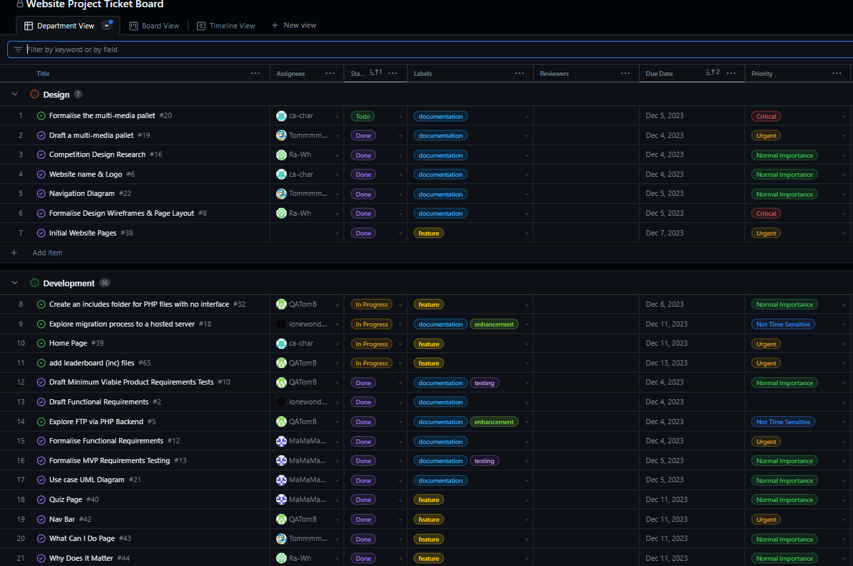
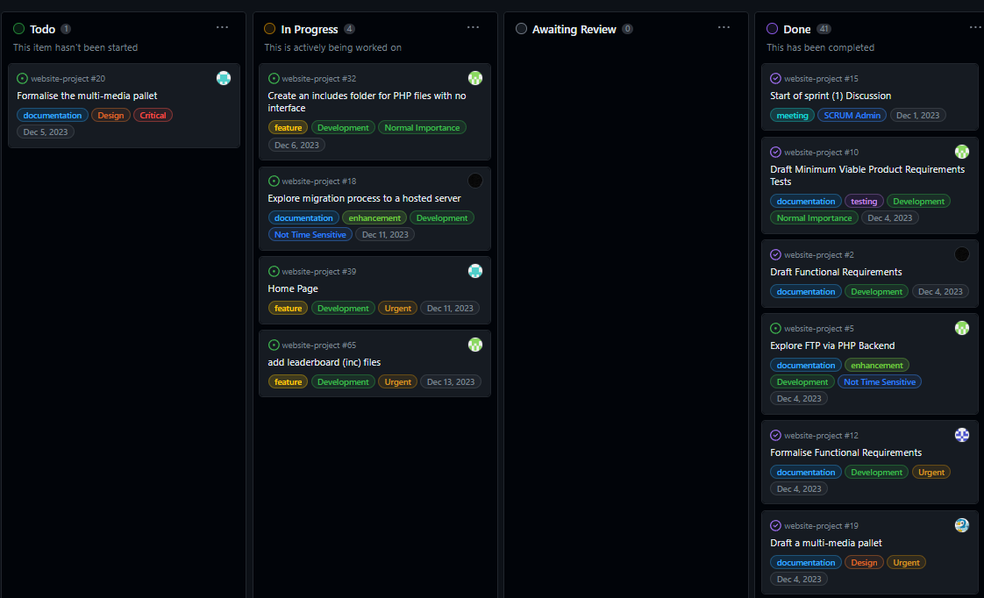
Project Management
We used the GitHub Projects features.
We used it to create “tickets” on functionality or tasks relating to all parts of the project. It allowed us to maintain a one stop place for all of the pending items that needed to be done.
The ticket board would also show the status of current pull requests. We could use due dates and labels to tie this changes to the current sprint.

Slide 5
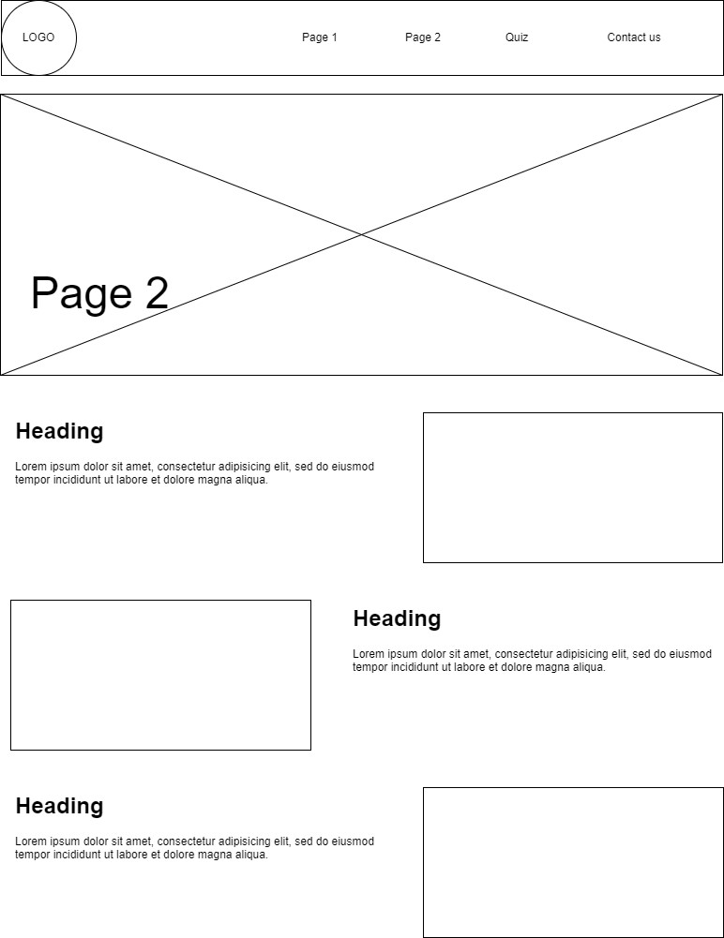
Documentation & Design
We wanted to follow the proper framework of software design and dedicated our first sprint entirely to developing comprehensive documentation, research and creating design guidelines that would enable all of us to produce a homogeneous result.
Our documentation and design research included;
Client Requirements
Functional Requirements
Example Page Wireframes
Case & Navigation UML Diagrams
Design research into other websites
User Stories (The basis for our client requirements)
MVP Testing Documentation
Functional Requirements Testing Documentation

Slide 6
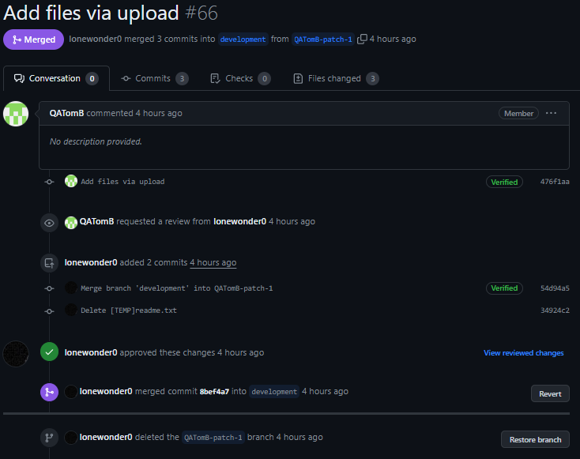
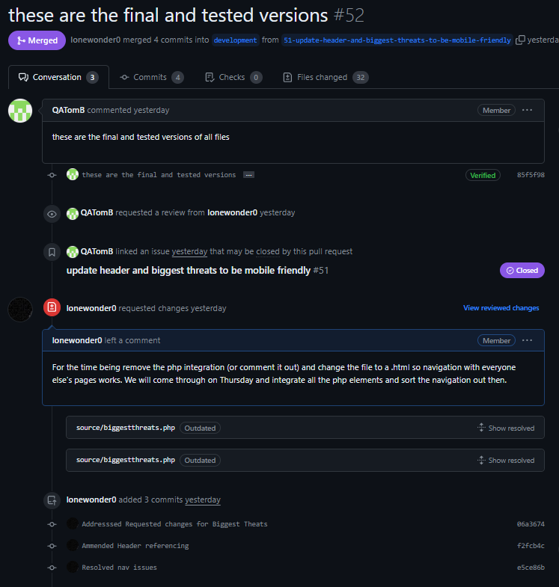
Source Control Workflow
Main
PR
Developmental
Commit
PR
PR
New Branch
Feature/Issue Branches
PR
Merge Branch

Slide 7
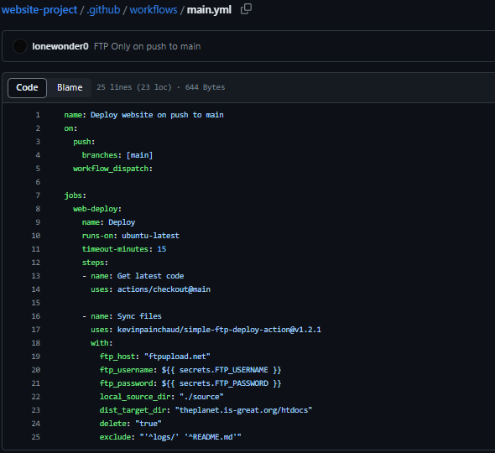
Integrations & Automation
We setup our backend development with GitHub actions, such that whenever code changes from development where merged to main the contents of ./source would be automatically (via FTP) be uploaded to our live server environment.
This allowed us to quickly roll out working releases and test functionality in a live environment.
We even used secret API keys to ensure this process was secure.

Slide 8
Difficulties that arose
Few of us had existing knowledge with GitHub and Git, and found working on code collaboratively using branches difficult to understand. Further training on this within our degree or at work would remove this as a problem.
Due to a rushed effort to finish our first sprint some of our design documentation wasn’t very detailed and we would veer off track and not follow design documentation.
Some members where more pressed for time than others and the workload wasn’t as balanced as it could have been.
Members didn’t have the infrastructure and environment to effectively use Git. Applications like GitHub desktop and the VS Code Git extension made collaboration easier but this proved a lot to learn in such a short period of time.
Despite developing a colour and media pallet some pages are stylistically different than others, we could have made this documentation more accessible.

Slide 9
What we did well
Our focus on a strong project management style served us well. We kept on schedule and had many artefacts to support our development.
Our focus on client over functional requirements permitted us to be flexible during development, given the timeframe we all agreed a minimum viable product was a more realistic goal. Using functional specifications as guidelines allowed us to “fail fast”.
We feel that we closely followed core Agile principles and source control convention as a requirement. At all points in our workflow we continuously asked “How would industry do it?” and followed best practise.
Because we re-defined this exercise as a means of “learning how to implement Agile” over “how to make a website” we feel our success is defined by our artefacts and project management as much as it is our end result. Given a longer time frame our versatile design would have yielded better returns on the time invested.

Slide 10
See our website live!
http://theplanet.is-great.org/

